Slide 1

Nutrition throughout the Life Cycle
Childhood & Preadolescence
Nick V. Neuwald, MS
Department of Nutritional Sciences
The Pennsylvania State University
Nutrition 451 – Fall 2021

Slide 2



Resources
AAP HealthyChildren.org – Gradeschool
  https://www.healthychildren.org/English/ages-stages/gradeschool/nutrition/Pages/default.aspx
Heathy Kids – American Heart Association
http://www.heart.org/HEARTORG/HealthyLiving/HeathyKids/Healthy-Kids_UCM_304156_SubHomePage.jsp
Nutrition.gov – Children
https://www.nutrition.gov/life-stages/children
Team Nutrition – USDA
https://www.fns.usda.gov/tn
ChooseMyPlate Kids
https://www.myplate.gov/life-stages/kids

Slide 3



    Defining the life stage
      Middle childhood: ~5-10 yrs old
      Preadolescence: ~9-11 for girls
      ~10-12 for boys
      “School age” or “Grade school”
      are common terms
      Children are in elementary
      school for most of this timeframe

Slide 4
Growth vs Development
Growth:
Development:

Slide 5
Growth vs Development
Growth: The progressive increase in the size of a child or parts of a child
Development:

Slide 6
Growth vs Development
Growth: The progressive increase in the size of a child or parts of a child
Development: The progressive acquisition of various skills (abilities) such as, speaking, learning, expressing feelings and relating with other people

Slide 7
Growth vs Development
Growth: The progressive increase in the size of a child or parts of a child
Development: The progressive acquisition of various skills (abilities) such as, speaking, learning, expressing feelings and relating with other people
Cognitive
Emotional
Social

Slide 8
Growth
Physical
  Slow, steady growth (~7 lb/year; ~2.5 inches/year)
    Lower rate/velocity compared to infants, toddlers, and adolescence
    Growth spurts are normal – appetite increases to compensate
    Plot growth on CDC Growth Charts; Monitor at least once per year
    Always use BMI-for-age https://www.cdc.gov/healthyweight/bmi/calculator.html
    Weight and height measured with scale and stadiometer (same way as in adults)
Notes:
Females:
Childhood minimum 16% fat
Puberty = 19%
Males:
Childhood minimum 13% fat
Puberty = 14%
More lean tissue

Slide 9
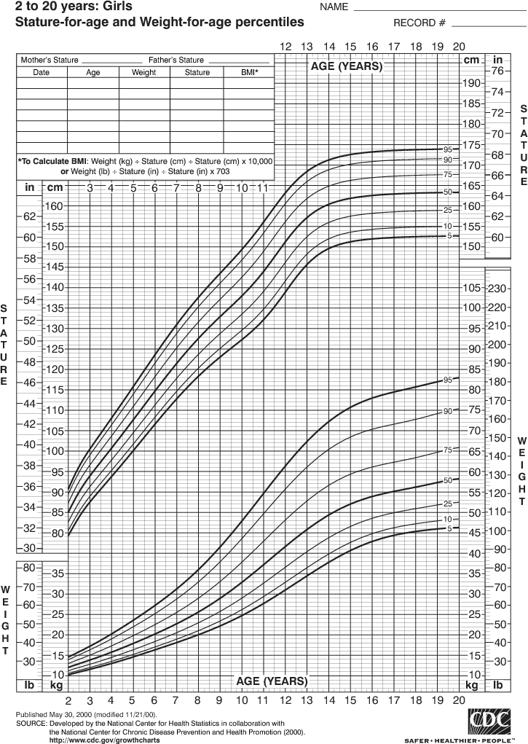

Slide 10
Physical Development
Physical
  ↑ Muscle strength, motor coordination, stamina
  Body composition -- ↑ body fat – ADIPOSITY REBOUND
    Greater ↑ in body fat in females (~16%) vs. males (13%)
    Preparation for adolescence

Slide 11
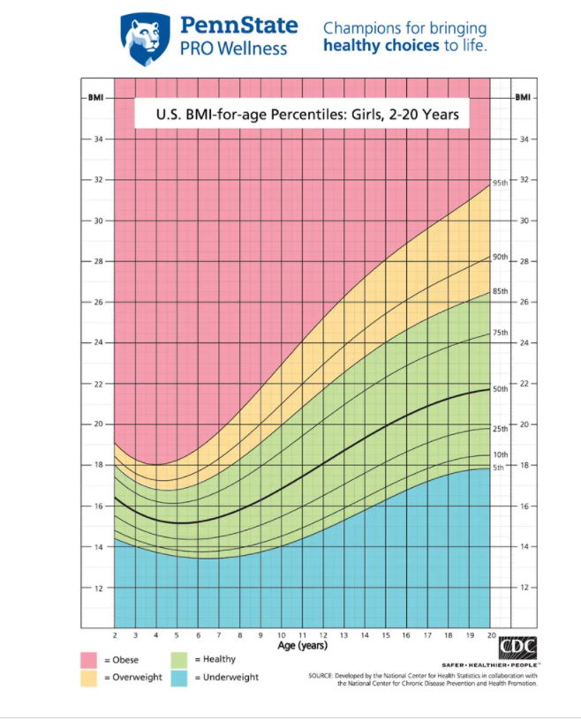
BMI Rebound

Slide 12

Cognitive Development
Cognitive
  ↑ self-efficacy, develop sense of self, independent
  Focus on many aspects of a situation at a time
  Can see “another’s” point of view
  Enjoy playing strategy games

Slide 13
Eating Behaviors
Influences on kids:
Parents and family members have greatest influence
School meals now have an influence
Peers begin to have a greater influence
Advertisements and fast food establishments market aggressively to children
Parents should:
Be responsible in serving variety of healthy foods on basic schedule
Have children participate in food shopping and preparation/cooking
Make time for family meals
Be a positive role model
Not use restrictive food practices
Not be overly concerned with weight

Slide 14

Family Meal Times
Forms positive memories surrounding food
Opportunity to model healthy eating behaviors
Helps reduce distracted eating from screens
Associated with better nutritional status, lower eating disorders, and lower risk of obesity
  BMI differences remain significant when controlling for SES

Slide 15
Screen time and Food Ads
8-12 yo Children watch an average of 4-6 hours of screen time per day¹
Food and toys are the two most commonly advertised products.
Most children younger than 6 do not understand the hidden purpose of advertising
9 out of 10 food ads on Saturday morning TV are for sugary cereals, candy, salty snacks, fatty fast foods and other junk food.
Television watching depresses metabolism
1. Screen Time and Children . (2021). Retrieved 31 October 2021, from https://www.aacap.org/AACAP/Families_and_Youth/Facts_for_Families/FFF-Guide/Children-And-Watching-TV-054.aspx

Slide 16


McDonalds Commercial 2013
https://www.youtube.com/watch?v=xh1F70SD0xg
advergames
Twitch food ads

Slide 17
Snacking
~25% of children's energy intake
Important for obtaining sufficient energy and nutrients
Typically highly energy dense, nutrient poor
Snacking should be encouraged, but healthy option provided
Vending machines in schools are an area for intervention

Slide 18
Eating Disorders
Early signs of eating disorders may start in middle childhood
Disordered eating in children more common if parents suffer with disordered eating
Responsive feeding over restrictive feeding
Pressure to diet, particularly for girls
Establish healthy routines

Slide 19


Use ChooseMyPlate for specific dietary recommendations

Slide 20
Energy and nutrient needs
Energy needs
  Reflects child’s activity level and body size
  ↓ in kcals/kg compared to toddlers & preschoolers
Protein
  4-13 y/o children: 0.95 g/kg body weight per day
  AMDR: 10-30%
CHO
  4-13 y/o children: 130 g per day
  AMDR: 45-65%

Slide 21
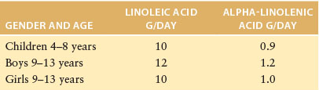
Fat
  General diet recommendations:
  Focus on healthy fats – omega-3 FA, MUFAs
  Low saturated fat and avoid trans fatty acids
AMDR for total fat
  25-35% of energy for children 4-18 years of age
  Adequate Intake (AI) for essential fatty acids:

Slide 22

Fiber
  Increase fresh fruits and vegetables, whole grain breads, and cereals
  Adequate Intakes (AI)
    4 to 8 yrs: 25 g/d
    Boys: 9-13 yrs: 31 g/d
    Girls: 9-13 yrs: 26 g/d

Slide 23
Micronutrients
Vitamins & Minerals
  Most nutrient needs are met with kids’ diets
  No supplement recommendations for healthy kids
  3 nutrients of concern:
    Calcium (bone mass), zinc (growth), iron (growth)
Age | Iron (mg/d) | Zinc (mg/d) | Calcium (mg/d)
4-8 years | 10 | 5 | 1000
9-13 years | 8 | 8 | 1300

Slide 24
Iron
Iron-rich foods: meats, dry beans & peas, fortified cereals
Iron Deficiency
  Not as common in this age group as in infants/toddlers or teenage girls
  Screening:
    Children on vegetarian or strict vegan diets
    Children with known risk factors for iron-deficiency anemia
  Anemia Diagnosis (remember, not always due to iron deficiency)
    5 up to 8 years old: Hb < 11.5 g/dL
    8 up to 12 years old: Hb < 11.9 g/dL
  Treatment:
    Iron supplementation
    Iron rich foods with Vit C to enhance absorption

Slide 25
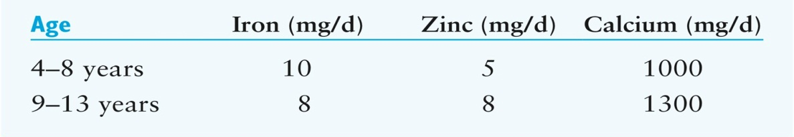
Calcium & Vitamin D
  Obtained by dairy foods, calcium & vitamin D fortified beverages and foods, fatty fish
  Vitamin D – skin production (UVB from sunlight)
  If lactose intolerant:
    Do not completely eliminate dairy products but decrease only to point of tolerance
RDAs
Same for boys and girls

Slide 26

Fluids – use thirst as a guide except with exercise
Water! (with and between meals)
Milk (or calcium fortified soy, almond, etc milk alternatives with low/no added sugar)
  2.5 c per day: 4-8 yrs
  3 c per day: 9+ yrs
Juices – 100% fruit juice
  No more than 1 cup per day
  (if any)
Avoid or limit use of soda, “fruit” cocktail drinks, sports drinks
  High in added sugar
  Avoid non-nutritive sweeteners (unknown effects)
If prolonged vigorous exercise
  Sports drinks or diluted juices are appropriate
NO energy drinks (high in caffeine) https://www.nccih.nih.gov/health/energy-drinks
  may harm children’s still-developing cardiovascular and nervous systems
  may cause serious heart and blood vessel problems
  may also be associated with anxiety, sleep problems, digestive problems, and dehydration

Slide 27

Dental Caries
  Affects ½ children ages 6-9
  Exposure to sugar main culprit
    Sticky candy
  Brushing regularly can help
  Source of fluoride (water/supplement)
  Dental caries / tooth loss may lead to difficulty chewing
Notes:
HEI: Healthy Eating Index
Factors that decreased score with age- lower milk and fruit intake, higher sodium intake

Slide 28

Exercise and physical activity
  Important for establishing good exercise behaviors
  Modeling, fostering social connections,
  Built environment important
  Exercises to maximize BMD
    Skeletal loading exercises
      Jumping, gymnastics
1. MacKelvie, K. (2002). British Journal Of Sports Medicine, 36(4), 250-257. doi: 10.1136/bjsm.36.4.250
Notes:
HEI: Healthy Eating Index
Factors that decreased score with age- lower milk and fruit intake, higher sodium intake

Slide 29
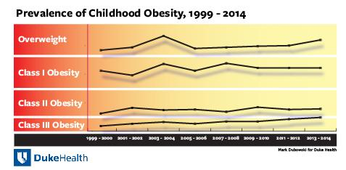
Childhood Obesity
Prevalence
  NHANES overweight/obese
    32.8% of 6-8 yo
    35.6% of 9-11 yo
Severity leading to different classes of obesity
Social stigma
  Most common reason for bullying in schools ¹
1. Bacchini, D., Licenziati, M., Garrasi, A., Corciulo, N., Driul, D., & Tanas, R. et al. (2015). Bullying and Victimization in Overweight and Obese Outpatient Children and Adolescents: An Italian Multicentric Study. PLOS ONE, 10(11), e0142715. doi: 10.1371/journal.pone.0142715
Notes:
HEI: Healthy Eating Index
Factors that decreased score with age- lower milk and fruit intake, higher sodium intake

Slide 30

Weight loss guidelines for children
Always risk of developing eating disorders with restrictive diet
  Goal is to minimize these risks as much as possible
Overweight
  Weight maintenance and slowing rate of weight gain
Type I Obesity (95th-98th%)
  Maximum 1 lb weight loss per week
Type II and III Obesity (>99th%)
  Maximum 2 lb weight loss per week
Weight loss surgery criteria
  History of obesity for at least 3 year
  BMI of at least 35 with 1 obesity related condition OR
  BMI of at least 40 without an obesity related condition
  Must have tried lifestyle change and not succeeded
Notes:
HEI: Healthy Eating Index
Factors that decreased score with age- lower milk and fruit intake, higher sodium intake

Slide 31
How are we doing?
Healthy Eating Index (HEI) | Pre-adolescents
Good Diet | 8%
Needed improvement | 79%
Poor Diet | 13%
Notes:
HEI: Healthy Eating Index
Factors that decreased score with age- lower milk and fruit intake, higher sodium intake

Slide 32
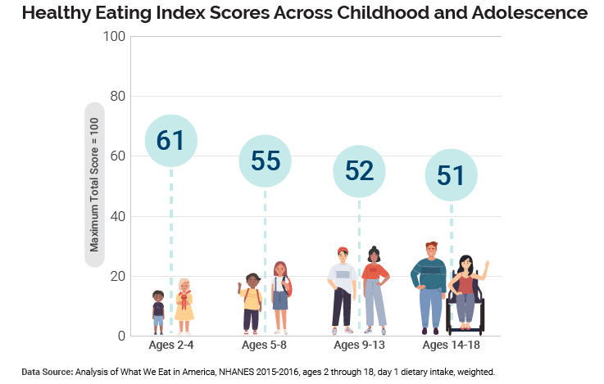

Slide 33

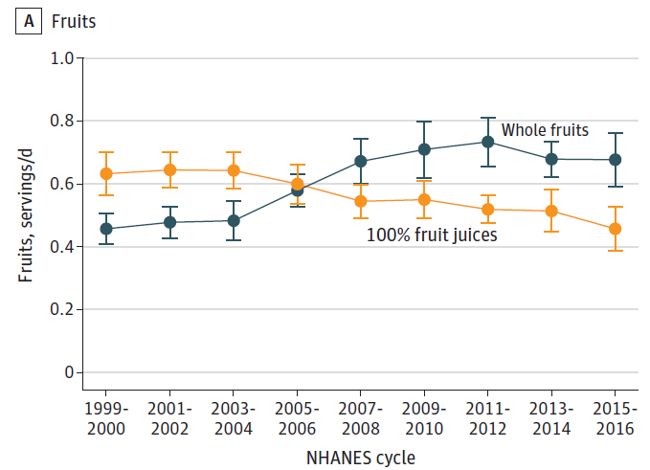
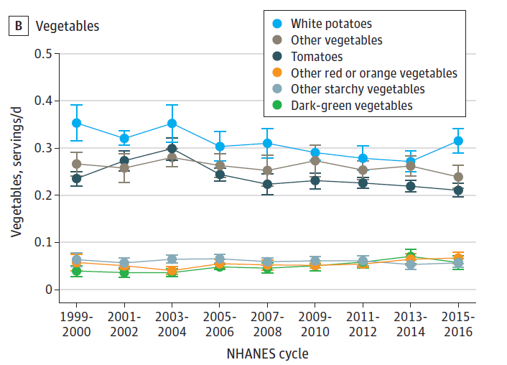
Trends in Estimated Mean Consumption of Key Food Groups and Nutrients Among US Youth Aged 2 to 19 Years by NHANES Cycles
From 1999-2000 to 2015-2016

Slide 34
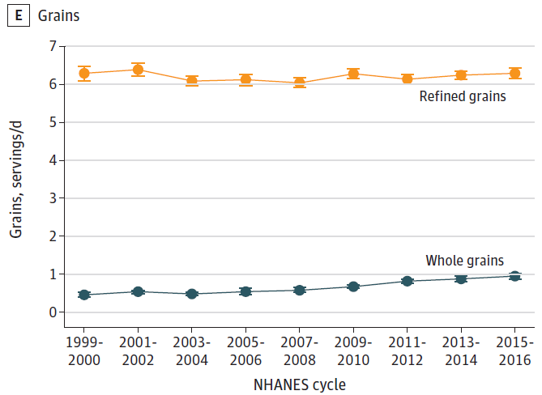
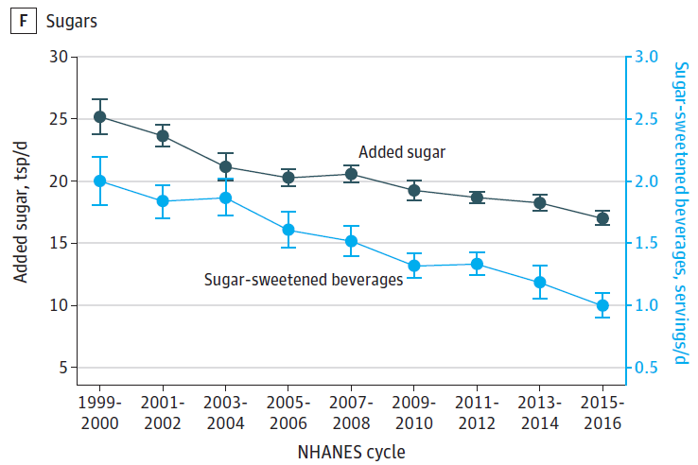
Trends in Estimated Mean Consumption of Key Food Groups and Nutrients Among US Youth Aged 2 to 19 Years by NHANES Cycles
From 1999-2000 to 2015-2016

Slide 35

Child Nutrition Programs
National School Lunch Program, School Breakfast Program, Child and Adult Care Food Program, Summer Food Service Program, Fresh Fruit and Vegetable Program, and Special Milk Program.
Affordable, nutrient dense, high-quality foods and beverages
Obstacles in schools
  Pouring rights
  Vending machines
  Competitive foods

Slide 36

School lunch @ SCASD during COVID

